Slide 1
Messaging

Slide 2
Use case

Slide 3
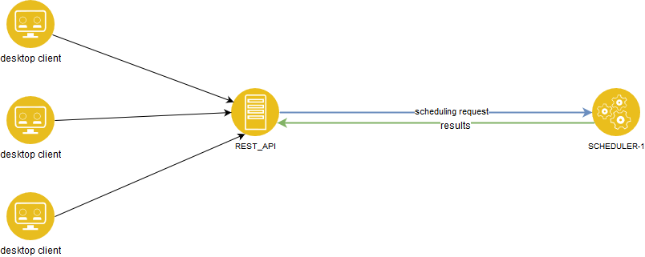
Epiqa - old architecture

Slide 4
Epiqa - new requirements
High availability =>
More schedulers are necessary
More rest-apis are necessary
Should not lose results if rest-api fails

Slide 5
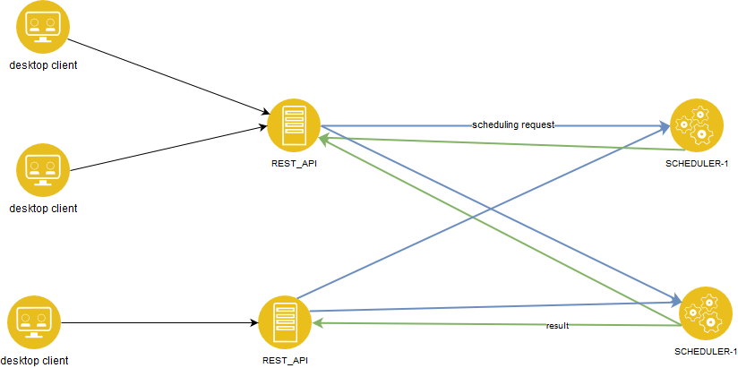
Epiqa - naive solution

Slide 6
Epiqa - naive solution
Many drawbacks
Every instance of rest-api has to know somehow about all schedulers
Rest-api must handle all failures
Strong coupling between rest-api and scheduler
Number of connections between rest-apis and schedulers grow rapidly
Increased complexity
Difficult error handling

Slide 7
Rabbit

Slide 8


Slide 9

RabbitMQ

Slide 10
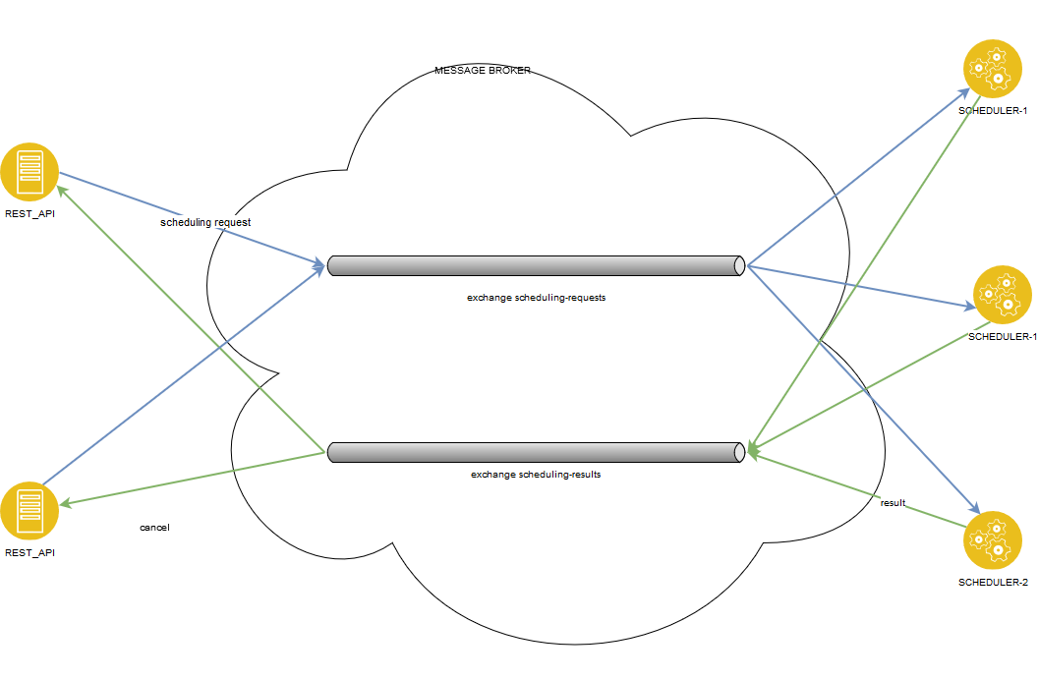
Epiqa - new architecture

Slide 11
Epiqa - new architecture
Decouples rest-api from scheduler =>
Failure of rest-api does not cause loss of results
Rest-api instances do not have to handle failures of scheduler and vice versa
Every instance of rest-api or scheduler has only two connections - one for request and one for results

Slide 12
What is message queue?
Software component which provides protocol for asynchronous inter-process communication
FIFO data structure
Decouples producer and consumer in
space - producer and consumer do not have to know each other
time - producer and consumer do not have to participate in the interaction at the same time
synchronization - the production and consumption of message does not happen in synchronous manner

Slide 13
Why to use it?
Decoupling
Scalability
Asynchronous communication
Resiliency
Notes:
https://blog.iron.io/top-10-uses-for-message-queue/
https://stackify.com/message-queues-12-reasons/

Slide 14
Protocols for messaging
AMQP - Advanced Message Queuing Protocol - feature-rich message queue protocol
STOMP - Streaming Text Oriented Messaging Protocol - simple, text-oriented message protocol
MQTT - MQ Telemetry Transport - extremely lightweight protocol especially for embedded devices

Slide 15
Examples of message brokers
RabbitMQ (AMQP, MQTT, STOMP)
ActiveMQ (AMQP, MQTT, STOMP)
ZeroMQ
Amazon SQS
HornetQ (AMQP, STOMP)
Apache Kafka

Slide 16
Hello world demo

Slide 17
RabbitMQ

Slide 18
Building blocks
Exchanges
Queues
Routing between exchanges and queues

Slide 19
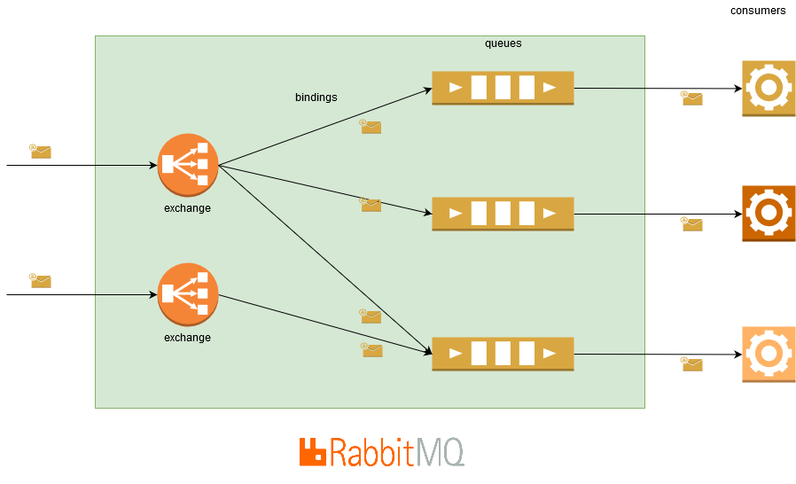
Building blocks

Slide 20
Basic flow
Publishers send messages to exchanges
Exchanges use bindings to route messages to queues or to other exchanges
Messages stay in queue until they are handled by consumers

Slide 21
Messaging Patterns
Publish/subscribe - producer publishes message and every subscriber gets it
Competing consumers - only one of the consumers gets the message
Request/reply - remote procedure call - not a typical use case for messaging

Slide 22
Exchange types
Direct
Topic
Fanout
Headers
Consistent-hash (via plugin)
Random exchange (via plugin)

Slide 23
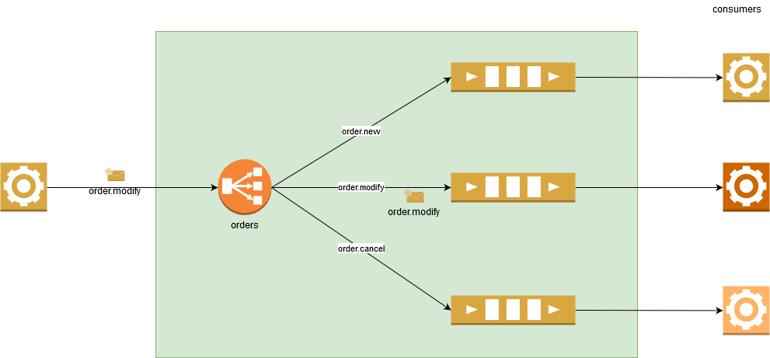
Direct exchange
routes messages with a routing key equal to the routing key declared by the binding queue

Slide 24
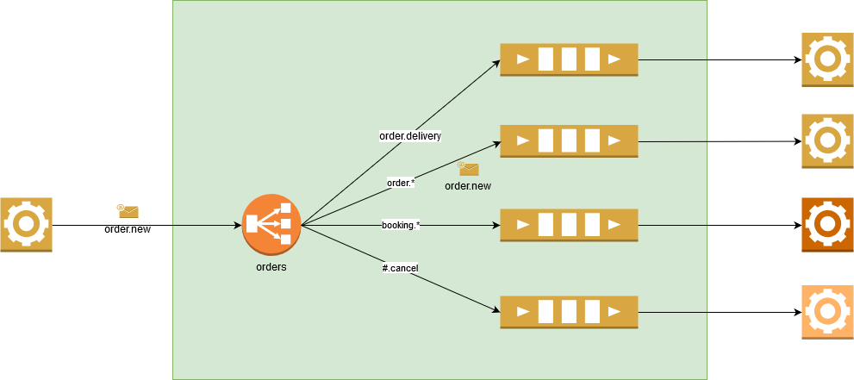
Topic exchange
routes messages to queues whose routing key matches all, or a portion of a routing key
“*” to match a word in a specific position of the routing key
“#” to match zero or more words

Slide 25
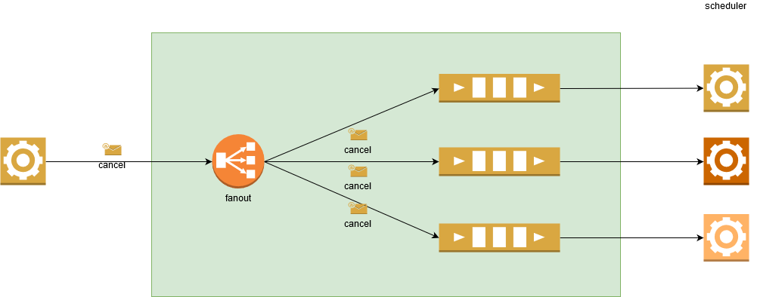
Fanout exchange
routes messages to all bound queues indiscriminately, routing key is ignored

Slide 26
Headers exchange
routes messages based upon a matching of message headers to the expected headers specified by the binding queue
similar to the topic exchange type but the criteria is expressed in the message headers

Slide 27
Delivery guarantees
At most once - message is delivered once or never
At least once - message is delivered once or more

Slide 28
At most once delivery
Message is acknowledged as soon as it is delivered to consumer
If the consumer fails immediately after message broker passed it the message then the message is lost
Auto-acknowledgement can be set during consumer subscription
Don’t use if you cannot afford to lose a message

Slide 29
At least once delivery
Message is acknowledged by consumer after it was processed
If the consumer fails before acknowledgement the message stays in the queue
If the consumer fails after it processed the message but before it acked it to the message broker then the message will be requeued and processed again by another consumer => your application must correctly handle multiple deliveries of the same message
Auto-acknowledge is much faster

Slide 30
At least once delivery demo

Slide 31
Performance
Throughput and latency depend on many factors
Message size
Queue size
Number of queues and consumers
Persistency settings - nonpersistent is faster
Ack settings - autoack is faster
Number of RabbitMQ nodes
Throughput of course depends also on the hardware but tens or hundreds of thousands of messages per second are achievable
Notes:
https://www.cloudamqp.com/blog/2017-12-29-part1-rabbitmq-best-practice.html
https://www.cloudamqp.com/blog/2018-01-08-part2-rabbitmq-best-practice-for-high-performance.html

Slide 32
High availability
To avoid being single point of failure the RabbitMQ itself should be distributed
Three modes - clustering, federation, and shovel - can be combined
Clustering mode:
Virtual hosts, exchanges, users, permissions are automatically mirrored
Queue may be located on single node or mirrored across multiple nodes
A client connected to a node can see all queues, even they are not located on that node
Each mirrored queue has one master and a few mirrors

Slide 33
Other exchanges and queues
Alternate exchange - used for to handle messages for which the exchange was unable to route them
Dead-letter exchange - exchange where rejected or expired messages are republished
Priority queue
Lazy queue - moves messages to disk as early as possible to allow long queues

Slide 34
Best practices
Reuse connection
Use one connection for producer and one for consumer
Use one channel per thread
Consume, don’t pull
Notes:
https://www.cloudamqp.com/blog/2018-01-19-part4-rabbitmq-13-common-errors.html

